Slide 1
Case Study Optimizing a code that helps quantify unknown protein concentration of gut content extracted from Polycyclic aromatic hydrocarbon (PAH) dosed mice versus control mice.
Anusha and Tosin

Slide 2
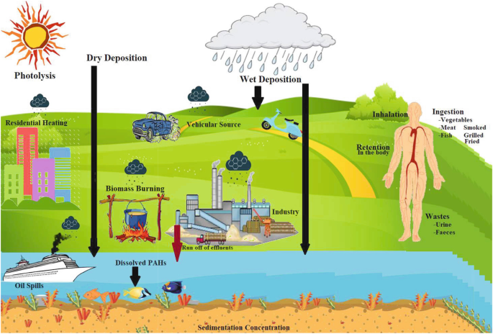
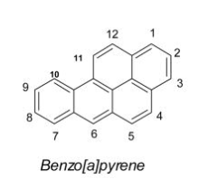
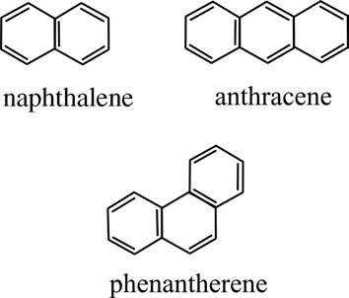
PAH EXPOSURE
The Environmental Protection Agency (EPA) has identified 16 unsubstituted PAHs as priority pollutants.
Notes:
PAHs are formed from incomplete

Slide 3
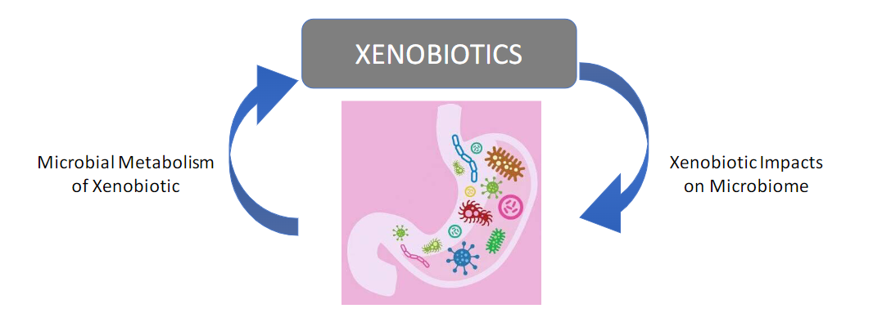
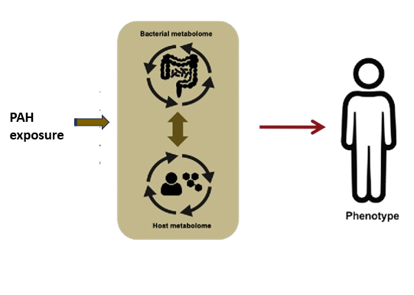
Gut Microbes Are Impacted By And Metabolize Xenobiotics
Several studies hypothesize that PAH exposure results in functional dysbiosis of the gut microbe.
To test this hypothesis, there is a need to study the key drivers of gut-microbe derived functions (metabolites and proteins).
This need highlights the importance of understanding sample processing of gut content.

Slide 4
Aim of Case Study
Aim: Optimize a code that helps quantify unknown protein concentration from raw absorbance data readings.
Experimental design:
Aliquoted 50mg of small intestine gut content of mice (male and females) exposed to PAHs versus undosed mice.
Isolated and extracted total proteins from gut content samples using the Pierce BCA Protein Assay Kit.
Obtained absorbance readings from plate reader.
Used ChatGPT to optimize a code that would help calculate unknown protein concentrations from absorbance readings.
Relevance:
It is important to have a way of quantifying total protein concentration from samples to allow for the normalization of these proteins for more downstream analysis.
Normalizing allows data to be comparable.
Notes:
This is a protein assay for determination of protein concentration.
Allows us test what differences are coming from exposure factor we’re trying to test.

Slide 5
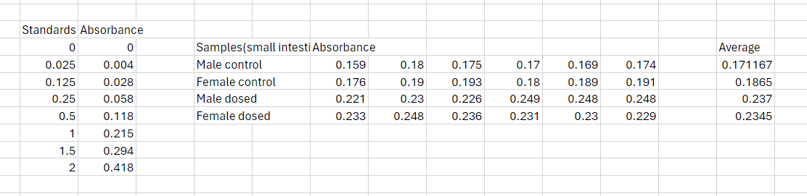
BCA Assay data

Slide 6
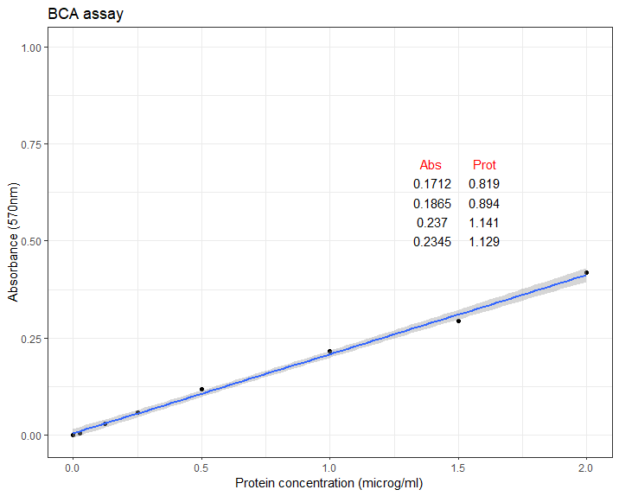
Plot created using R

Slide 7
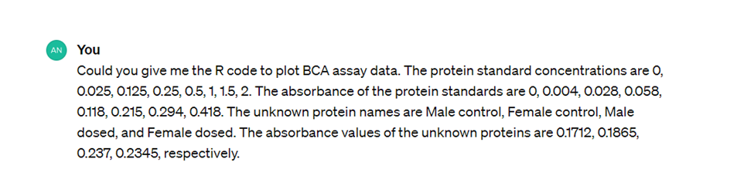
Chatgpt prompt

Slide 8
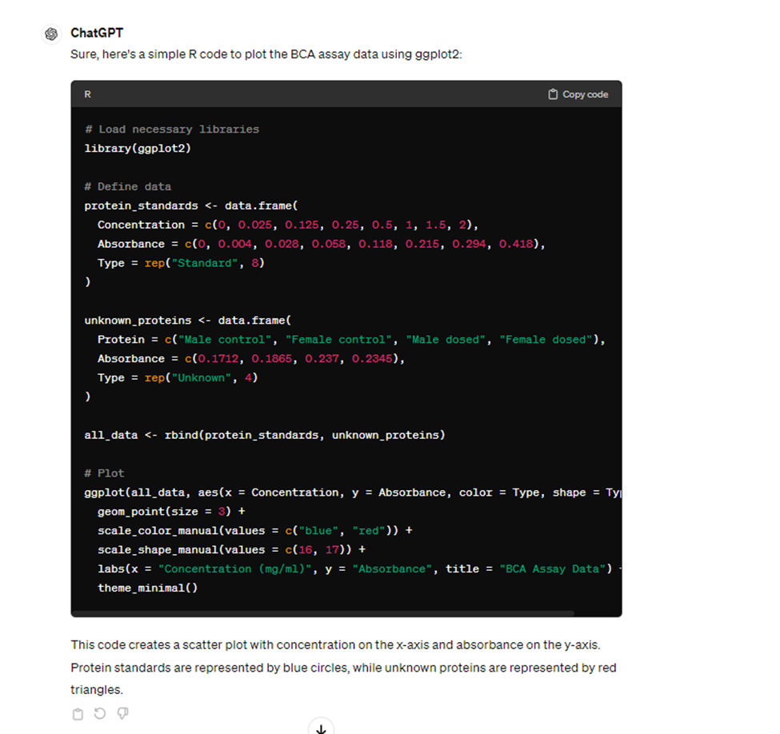
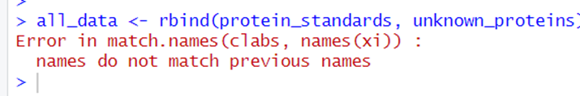

Slide 9
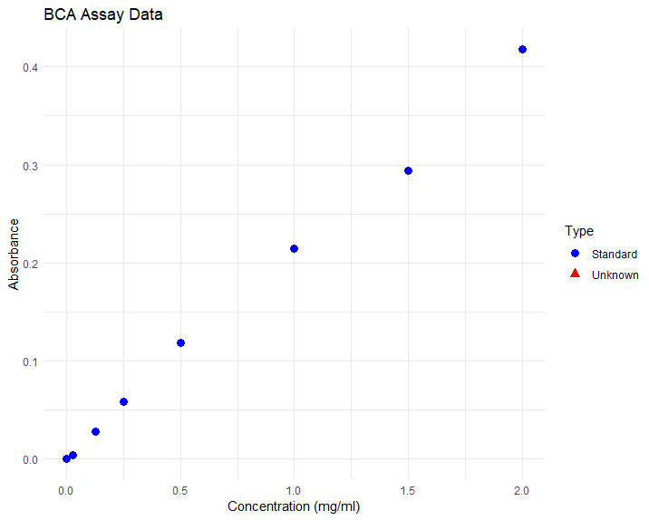

Slide 10
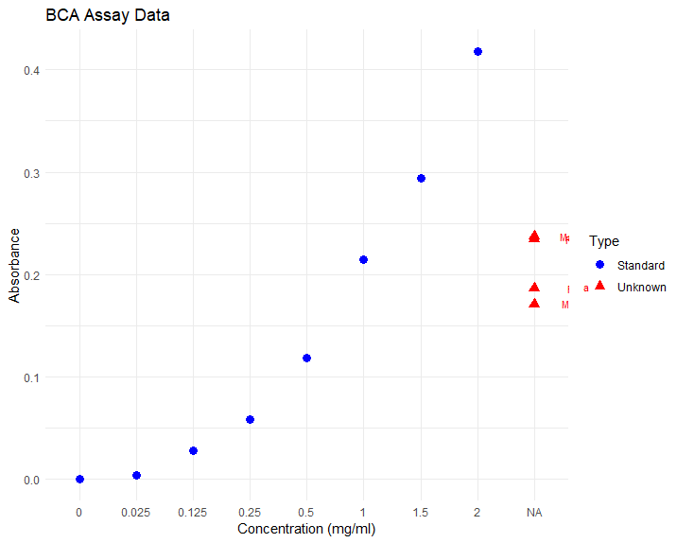

Slide 11
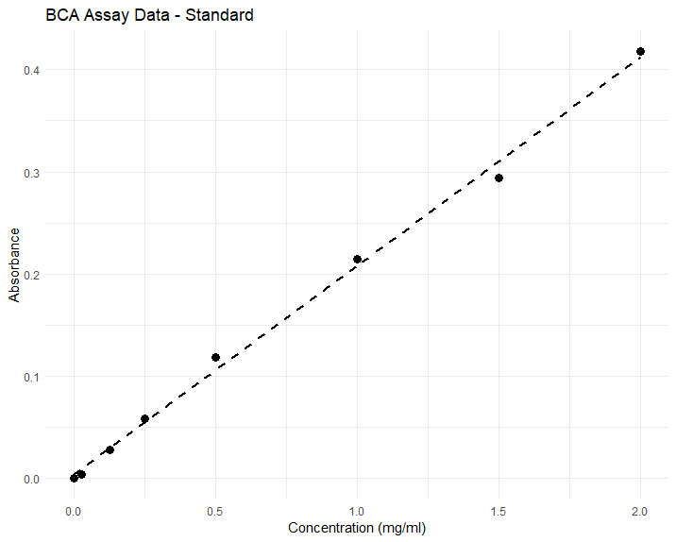

Slide 12
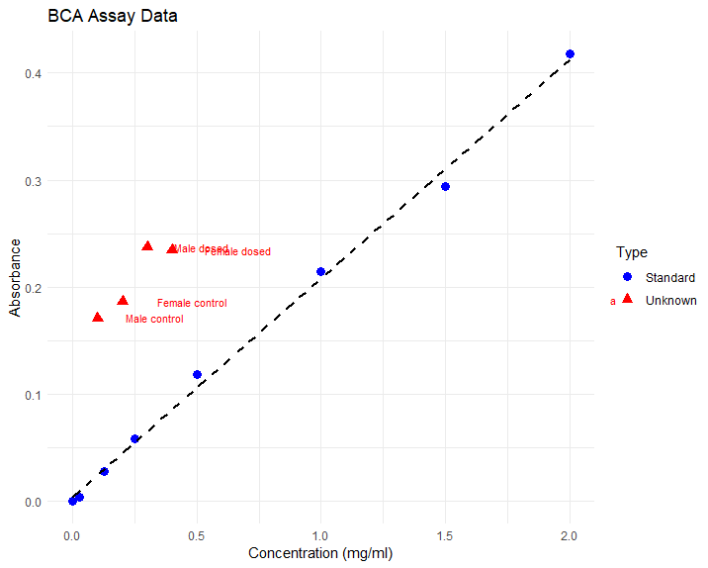

Slide 14
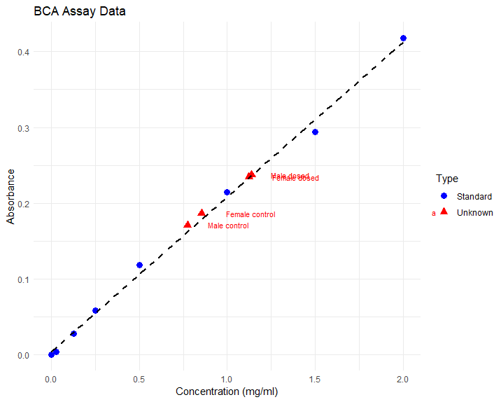

Slide 15
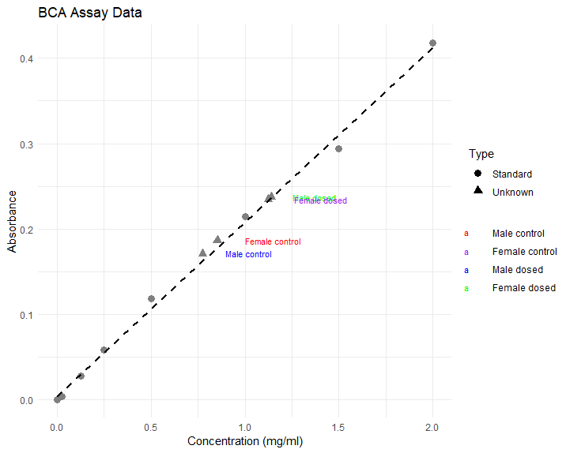

Slide 16
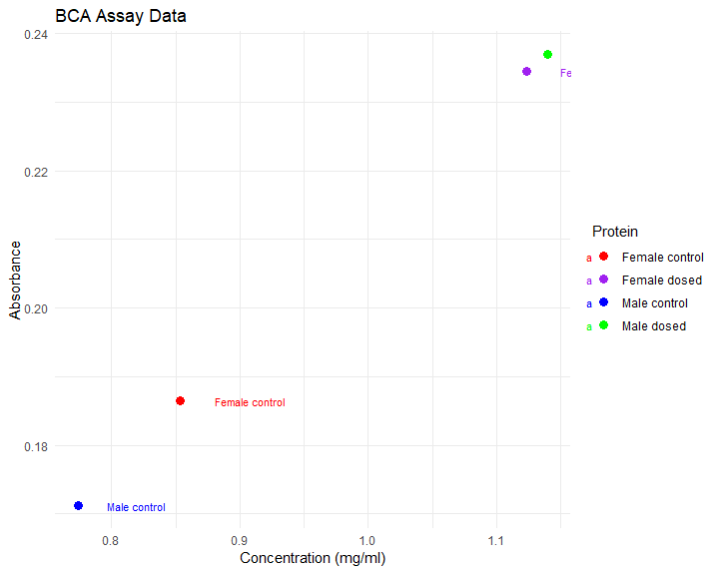

Slide 17
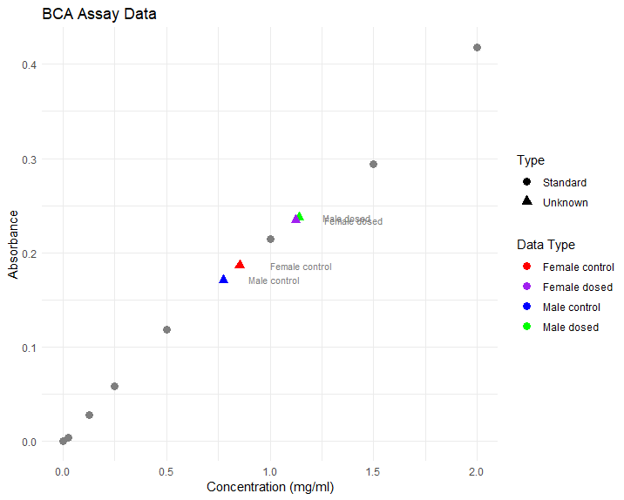

Slide 18
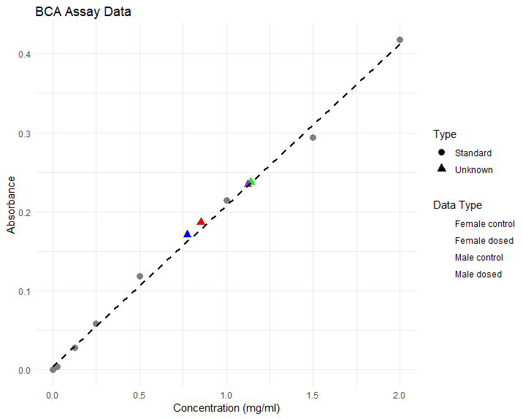

Slide 19
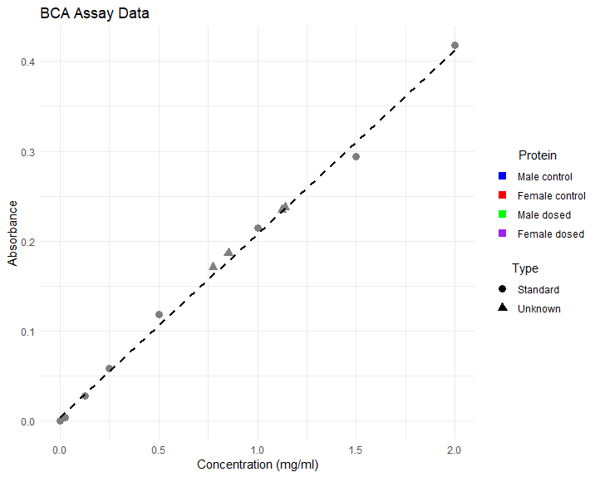

Slide 20


Slide 21
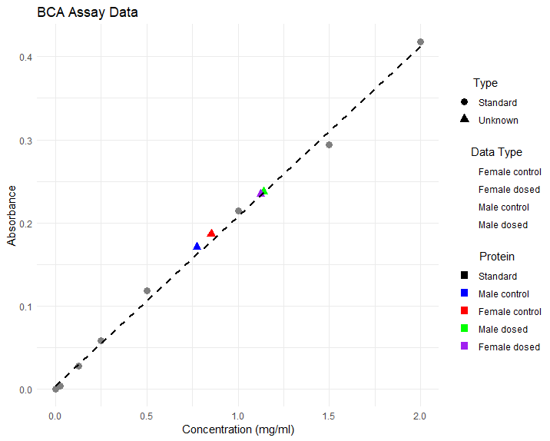

Slide 22

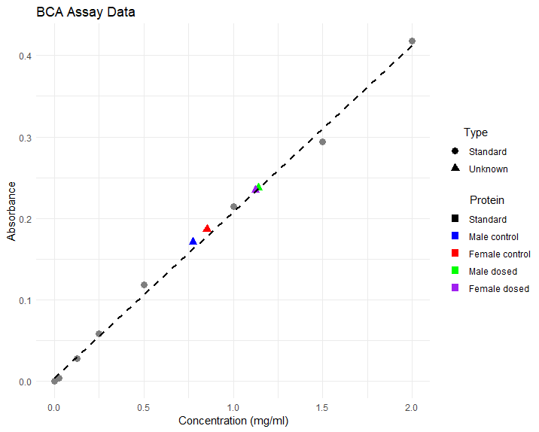

Slide 23
Without Chatgpt
With Chatgpt

Slide 24

Thank you for listening!
Questions!!

